Slide 1

Operating Systems BCSC 0004
Deadlocks

Slide 2
Deadlock
In a multiprogramming system, a number of process compete for limited number of resources and if a resource is not available at that instance then process enters into waiting states.
If a process unable to change its waiting state indefinitely because the resources required by it are held by another waiting process then system is said to be in deadlock.
R2
P1
P2
R1

Slide 3
System Model
Every process will request for the resources.
If entertained then, process will use the resources.
Process must release the resource after use.

Slide 4
Necessary Condition of Deadlock
Mutual exclusion: At least one resource type in the system which can be used in non- shareable mode i.e mutual exclusion (one at a time/ one by one) e. g. CPU time, printer.
Hold and wait: A process is currently holding at least one resource and requesting additional resources which are being held by other processes.
No-preemption: A resource can not be preempted from a process by any other process resource can be released only voluntarily by the process holding it.

Slide 5
Necessary Condition of Deadlock
Circular wait: Each process must be waiting for a resource which is being held by another process, which in turn is waiting for the first process to release the resources.
P1
P2
P3

Slide 6
Deadlock handling Methods
Prevention: Means design such a system which violate at least one of four necessary conditions of deadlock and ensure independence from deadlock.
Avoidance: system maintains a set of data using which it takes a decision weather to entertain a new request or not, to be in safe state.
Detection and recovery: Here we wait until deadlock occurs and once we detect it then recover from it.
Ignorance: we ignore the problem as if it does not exist.

Slide 7
Deadlock Prevention
This guarantees that there is no deadlock.
Prevention method cannot violate the mutual exclusion condition.
Violate Hold and wait
Conservative approach: Process is allowed to start execution if and only if it has acquired all the resources. (Less efficient, not implementable, easy, deadlock independence)
Do not hold: Process will acquire only desired resources, but before making any fresh request it must release all the resources that it currently hold. (Efficient, implementable)
Wait timeouts: we place a maximum time upto which a process can wait. After which process must release all the holding resources & exit.

Slide 8
Deadlock Prevention
Violate No- Preemption
Forcefully preemption: we allow a process to forcefully preempt the resources holding by other process.
This method may be used by high priority process or system process.
The process which are in waiting state must be selected as a victim instead of process in the running state.

Slide 9
Deadlock Prevention
Violate circular wait
Circular wait can be eliminated by first giving a natural number of every resource
F : N→ R
Allow every process to either only in the increasing or decreasing order of the resource number.
If a process require a lesser number (in any of increasing order), then it must first release all the resources larger than required number.

Slide 10
Deadlock Avoidance
A deadlock avoidance algorithm dynamically examines the resource allocation state.
The resource allocation state is defined by the number of available and allocated resources and the maximum demands of the processes before allowing that request first.
We check, if there exist “ some sequence in which we can satisfies demand of every process without going into deadlock, if yes the sequence is called safe sequence” and request can be allowed. Otherwise there is a possibility of going into deadlock.

Slide 11
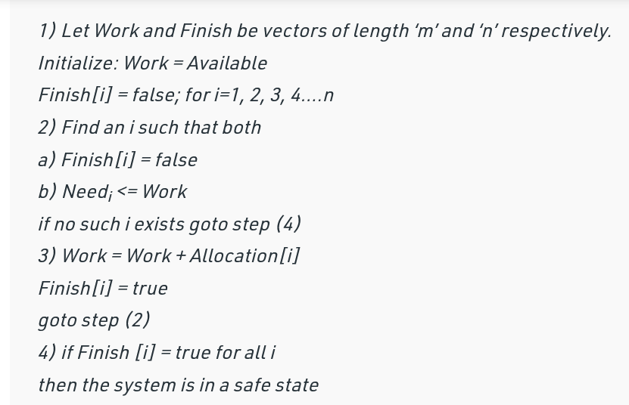
Banker’s Algorithm
The banker’s algorithm is a resource allocation and deadlock avoidance algorithm that tests for safety.
The algorithm for finding out whether or not a system is in a safe state.

Slide 12
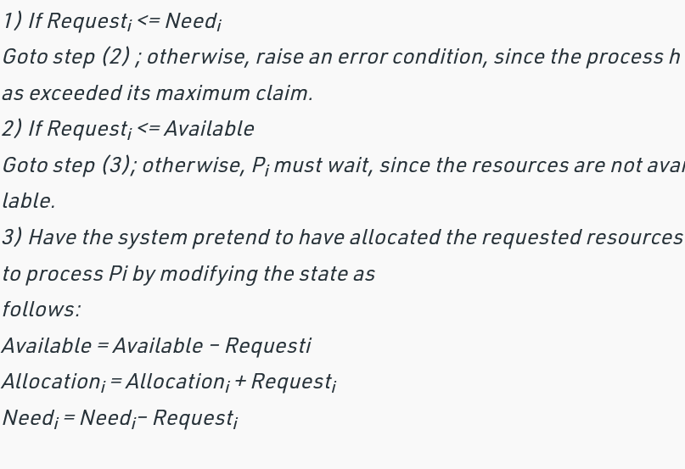
Resource-Request Algorithm

Slide 13
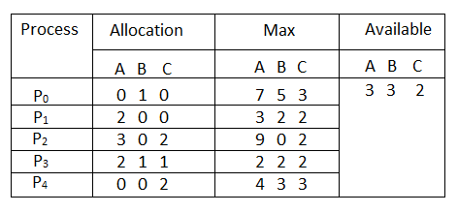
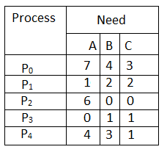
Considering a system with five processes P₀ through P₄ and three resources of type A, B, C. Resource type A has 10 instances, B has 5 instances and type C has 7 instances. Suppose at time t₀ following snapshot of the system has been taken:

Slide 14
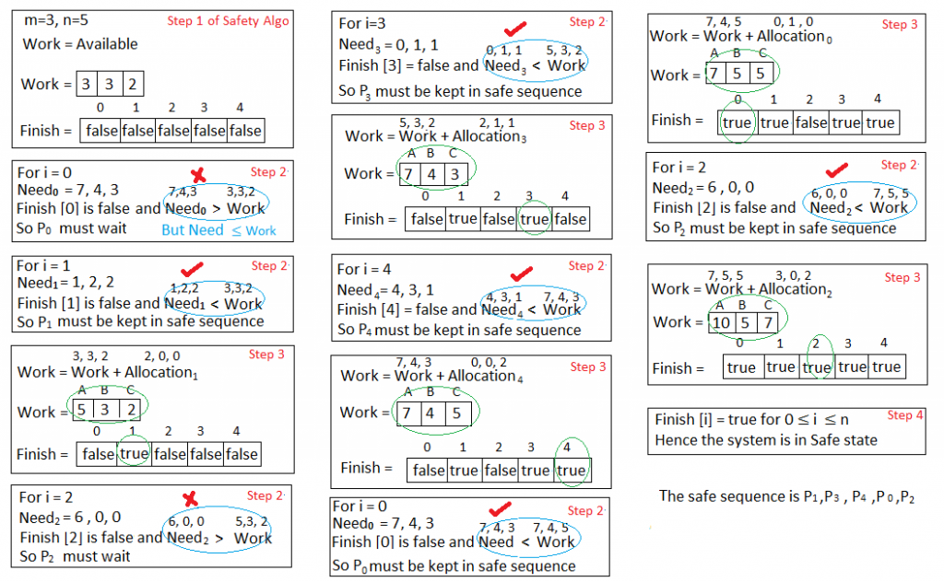
Is the system in a safe state? If Yes, then what is the safe sequence? Applying the Safety algorithm on the given system,

Slide 15
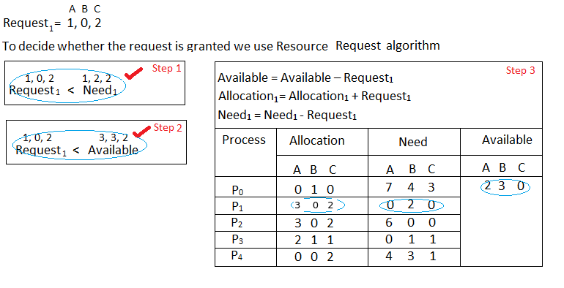
What will happen if process P₁ requests one additional instance of resource type A and two instances of resource type C?

Slide 16
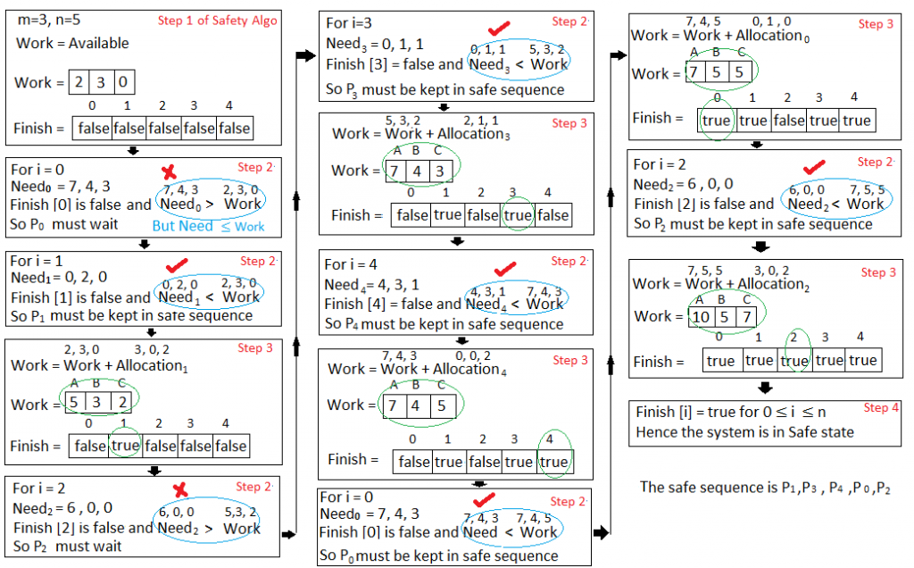
Hence the new system state is safe, so we can immediately grant the request for process P₁

Slide 17
If a request (3 , 3, 0) by process P4 arrives in the state defined by above can it be granted immediately?
If a request (0 , 2, 0) by process P0 arrives then check weather it is granted or not? If granted then the new state of the system?

Slide 18
Process | Allocation |  |  | Need |  |  | Available
P0 | 0 | 3 | 0 | 7 | 2 | 3 | 2 | 1 | 0
P1 | 3 | 0 | 2 | 0 | 2 | 0
P2 | 3 | 0 | 2 | 8 | 0 | 0
P3 | 2 | 1 | 1 | 0 | 1 | 1
P4 | 0 | 0 | 2 | 4 | 3 | 1
All five processes are in waiting state as none is able to satisfy the condition
Need_{i} < Available

Slide 19
Deadlock detection and recovery
Here we do not check safety and where any process request for some resources then these resources are allocated immediately, if available.
Here there is a possibility of deadlock, which must be detected using different approach.
Active approach: here we simply invoke the algorithm at defined intervals for example once per hour or whenever CPU utilization drop below 40%.
Lazy approach: whenever CPU utilization drops below 40 % or some unusual performance is there, we go for detection.

Slide 20
Deadlock recovery
Optimistic approach | Pessimistic approach
Pre-empt some resources from processes and give these resources to other processes until the deadlock cycle is broken. Handles the three problems Selecting a victim process Rollback Starvation | Process termination Abort all deadlock process (Costly) Abort one process at a time and decide next to abort after deadlock detection. Some factor based on these process will be terminated: Priority of the process How long the process has completed How much longer a process will compute before completion How many and what type of resources process has used How many resources the process needs to complete its execution.

